Slide 1

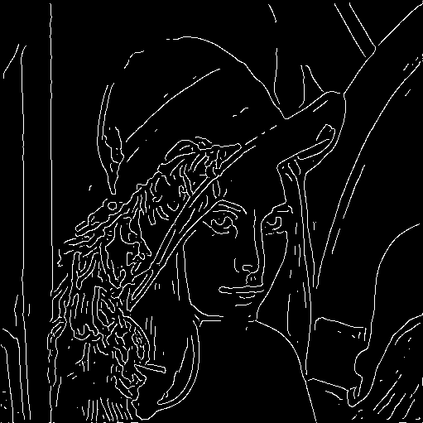
Image gradients and edges
Class 3: Computational Vision
Source of most slides: Kristen Grauman, UT-Austin

Slide 2
Last lecture
Various models for image “noise”
Linear filters and convolution useful for
Image smoothing, removing noise
Box filter
Gaussian filter
Impact of scale / width of smoothing filter
Median filter:
a non-linear filter,
assuring no averaging and inventing grey-levels,
edge-preserving

Slide 3
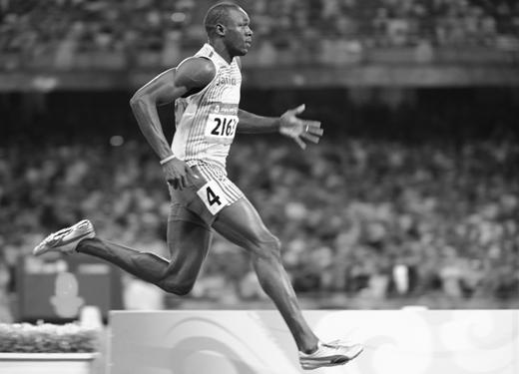

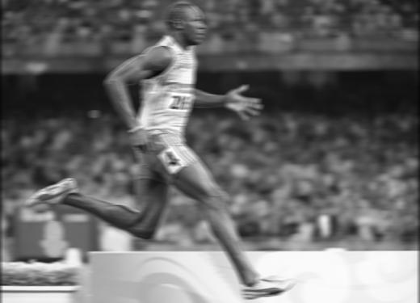
Review
f*g=?
original image
filtered
Filter f = 1/9 x [ 1 1 1 1 1 1 1 1 1]^{T}
What happens if we have a smoothing filter that is unnormalized (does not sum to one)?

Slide 4
Recall: image filtering
Compute a function of the local neighborhood at each pixel in the image
Function specified by a “filter” or mask saying how to combine values from neighbors.
Uses of filtering:
Enhance an image (denoise, resize, etc)
Extract information (texture, edges, etc)
Detect patterns (template matching)
Adapted from Derek Hoiem

Slide 5
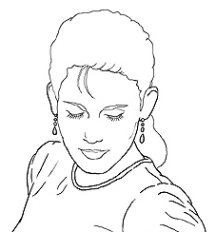
Edge detection
Goal: map image from 2d array of pixels to a set of curves or line segments or contours.
Why?
Main idea: look for strong gradients, post-process
Figure from J. Shotton et al., PAMI 2007

Slide 6
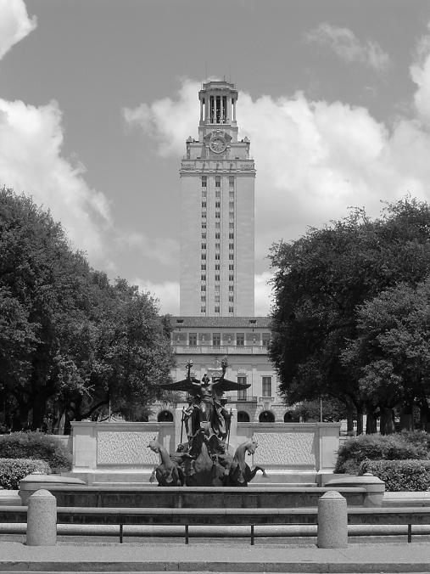
What does cause an edge?
Depth discontinuity: object boundary
Reflectance change: appearance information, texture
Cast shadows
Change in surface orientation: shape

Slide 7
Edges/gradients and invariance

Slide 8

Derivatives and edges
An edge is a place of rapid change in the image intensity function.
intensity function (along horizontal scanline)
image
first derivative
Edges correspond to extrema of derivative
(max by absolute value)
Source: L. Lazebnik

Slide 9
Derivatives with convolution
For 2D function, f(x,y), the partial derivative is:
For discrete data, we can approximate using finite differences:
To implement above as convolution, what would be the associated filter?

Slide 10
First derivatives: discrete operators.
Given that the function f to derive is the image I:
To implement above as convolution, what would be the associated filter h?
Remember:
y
x
Petia Ivanova Radeva
*We substituted I_{i,j} by I[i,j] for sake of visibility.
10
Notes:
10

Slide 11
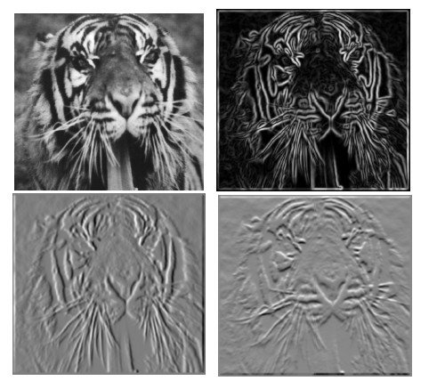
Partial derivatives of an image
?
-1 1
1 -1
-1 1
or
Which one does show changes with respect to x?

Slide 12
First derivatives: discrete operators.
But how to be less sensitive to noise?
Given that the function f to derive is our image I:
y
x
Alternative: getting the average of the 3 derivatives in order to be less sensitive to noise:
Petia Ivanova Radeva
12
Notes:
12

Slide 13
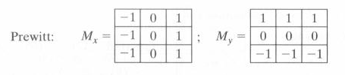
First derivatives: discrete operators.
If we consider symetric finite differences:
y
x
Petia Ivanova Radeva
13
Notes:
13

Slide 14
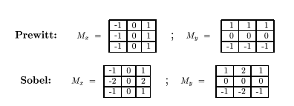
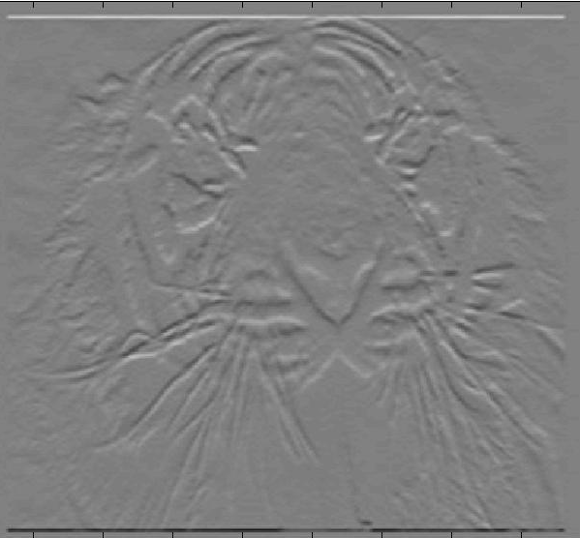
Assorted finite difference filters
What is the difference between the Prewitt and Sobel operators?
- Sobel, by using non-uniform weights, gives more importance to the closest neighbors.
Which do you expect to be better?

Slide 15
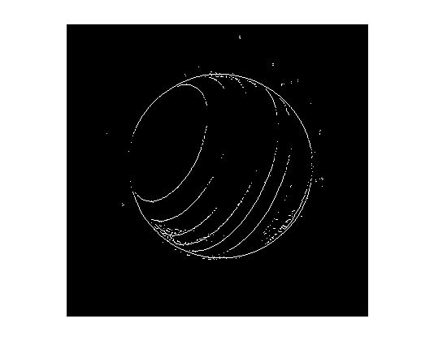
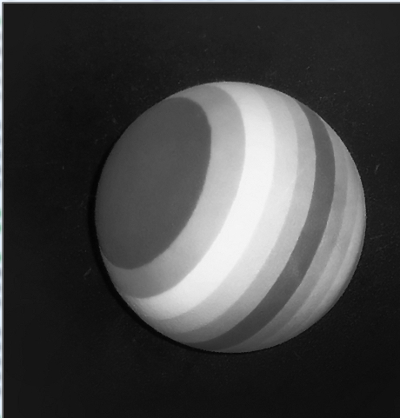
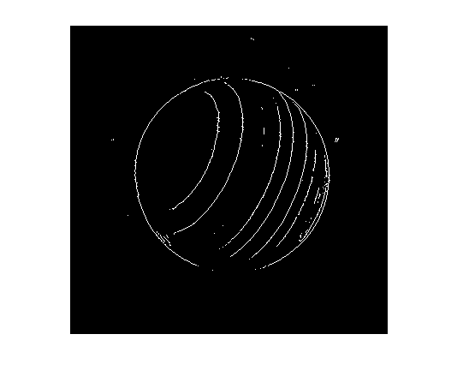
Assorted finite difference filters
Determine to which Sobel masks (wrt x and y) do these images correspond to?!
How to apply Sobel in Matlab to detect the edges?
Alternative:
edge() -> Find edges in grayscale image
>> BW = edge(I)
>> BW = edge(I,'sobel')
>> BW = edge(I,'sobel',thresh,direction)
>> BW = edge(I,‘prewitt’)
Matlab:
>> My = fspecial(‘sobel’);
>> outim = imfilter(double(im), My);
>> imagesc(outim);
>> colormap gray;
Petia Ivanova Radeva
How to combine both derivatives (in x and y)?
15
Notes:
15

Slide 16

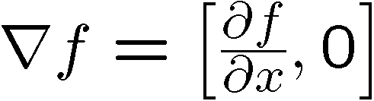
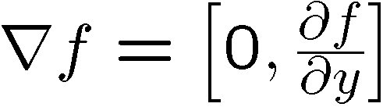
Image gradient
The gradient of an image:
The gradient points in the direction of most rapid change in intensity
Slide credit Steve Seitz
Notes:
16

Slide 17
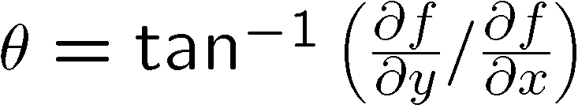
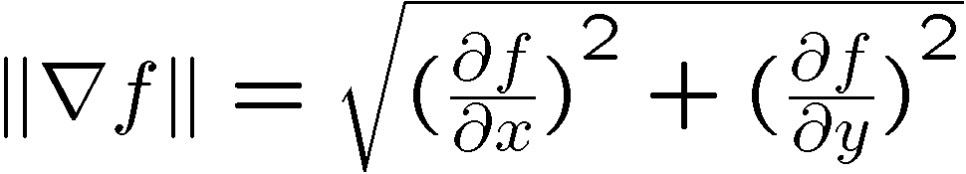
Image gradient
The gradient direction (orientation of edge normal) is given by:
The edge strength is given by the gradient magnitude
Slide credit Steve Seitz
Notes:
17

Slide 18
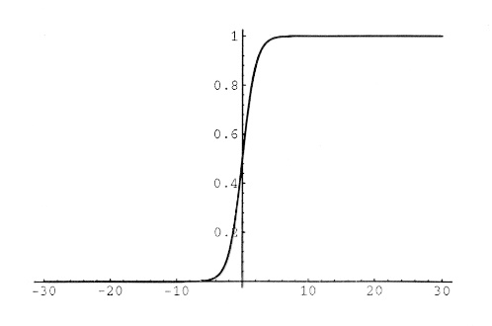
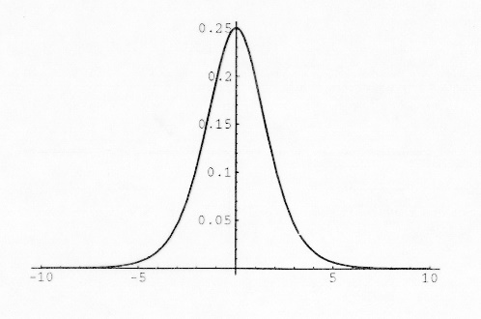
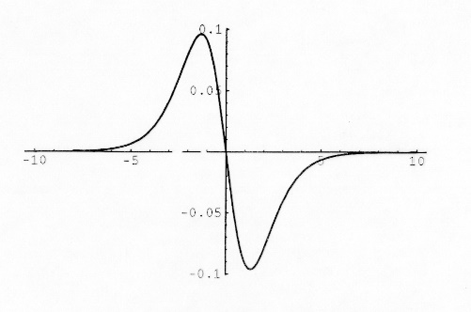
Discrete operators: second derivatives
What do you expect about the second derivatives?
Given an edge, the first derivative has an extreme, and the second one has a zero-crossing in the edge and extremes before and after the edge.
y
The second derivative is the derivative of the first derivative:
x
Petia Ivanova Radeva
18
Notes:
18

Slide 19
Discrete operators: Laplacian
Let’s define:
Laplacian mask:
y
x
Petia Ivanova Radeva
19
Notes:
19

Slide 20
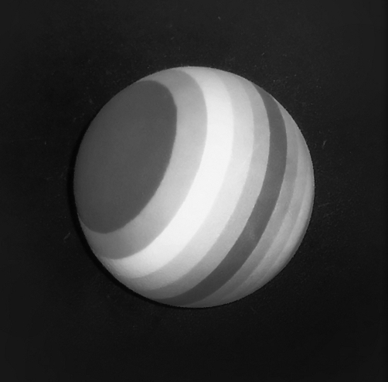
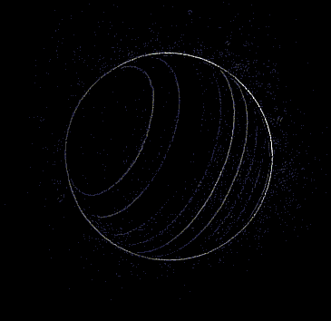
Discrete operators: Laplacian
Laplacian mask:
Matlab:
h = fspecial('laplacian', alpha) returns a 3-by-3 filter approximating the shape of the two-dimensional Laplacian operator. The parameter alpha controls the shape of the Laplacian and must be in the range 0.0 to 1.0.
B = imfilter(im, h) filters the image im with the filter/mask h.
Petia Ivanova Radeva
20
Notes:
20

Slide 21
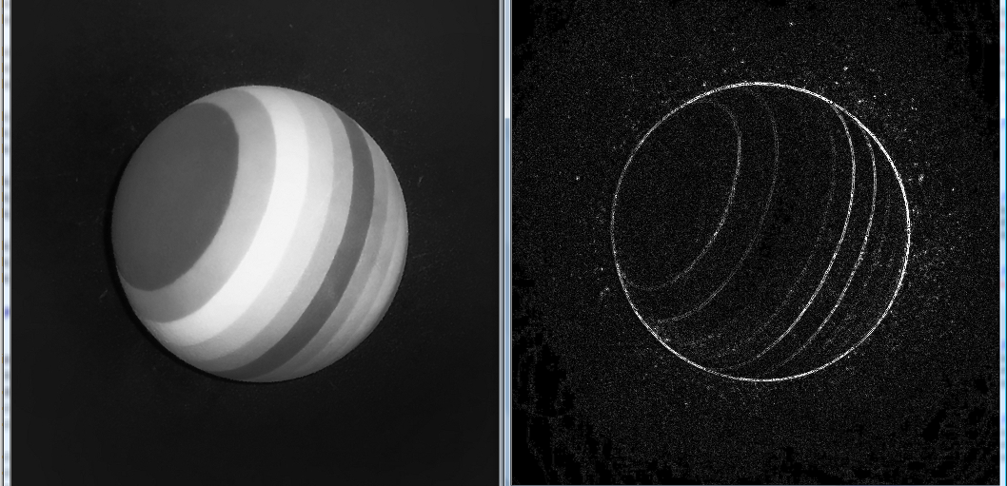
Discrete operators: Laplacian
Including the diagonal neighbours:
Laplacian:
Petia Ivanova Radeva
21
Notes:
21

Slide 22
Mask properties
Test on smoothing
Values should be _________
Sum to ___→ constant regions same as input
Amount of smoothing _____________ to mask size
Remove “______-frequency” components; “______-pass” filter
Test on derivatives
___________ signs used to get high response in regions of high contrast
Sum to ___ → no response in constant regions
_______________ value at points of high contrast

Slide 23
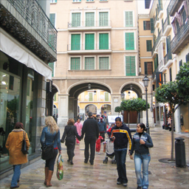
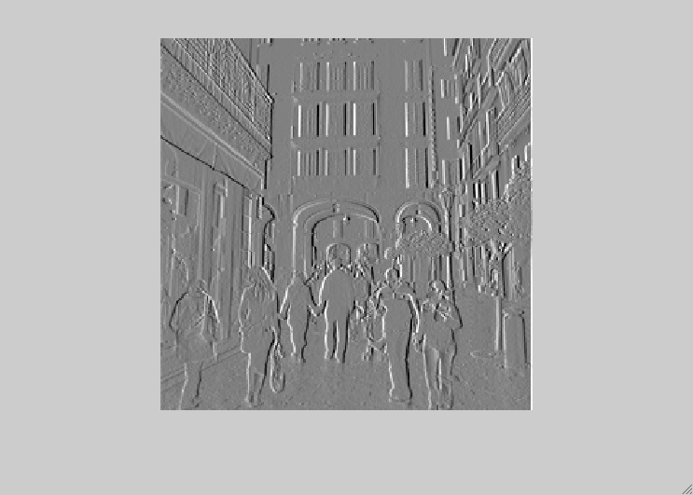
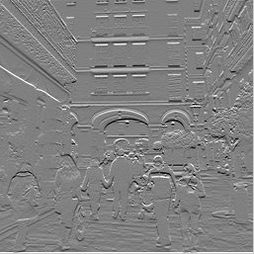
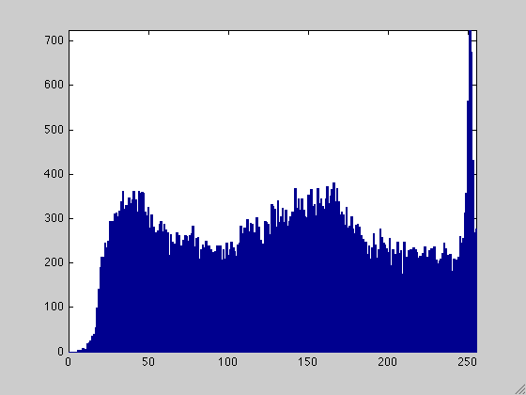
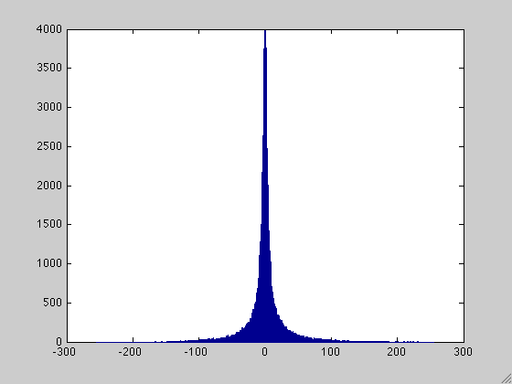
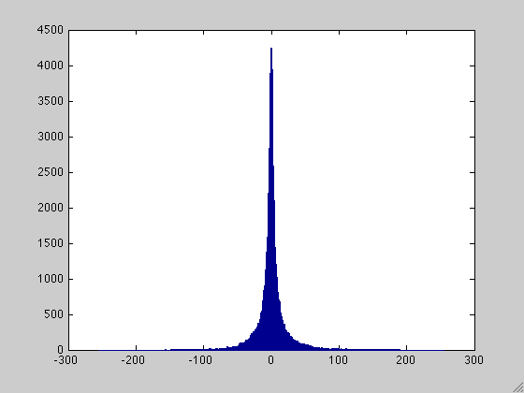
Explain the histogram of x and y edge maps
Horitzontal and vertical derivatives distribution: why are they positive and negative?
Why the maxima is in 0? Can I store them in a uint8 type image?.
Notes:
23

Slide 24
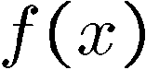
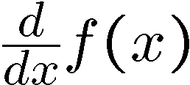
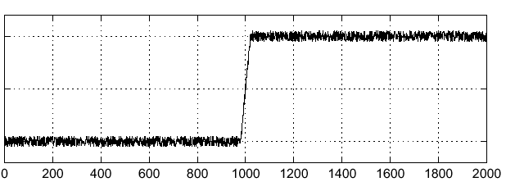
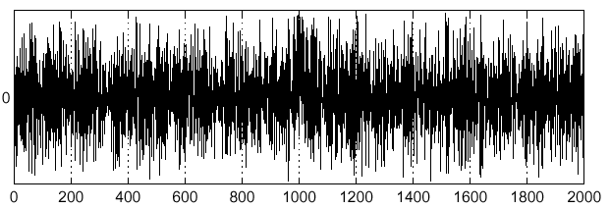
Effects of noise
Consider a single row or column of the image
Plotting intensity as a function of position gives a signal
Where is the edge?
Slide credit Steve Seitz

Slide 25
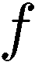
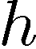
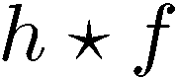
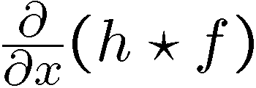
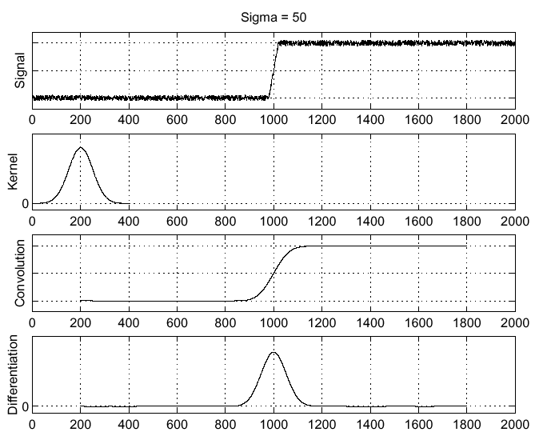
Solution: smooth first
Where is the edge?
Look for peaks in

Slide 26
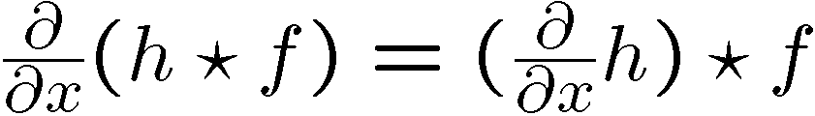
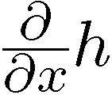
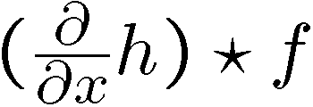
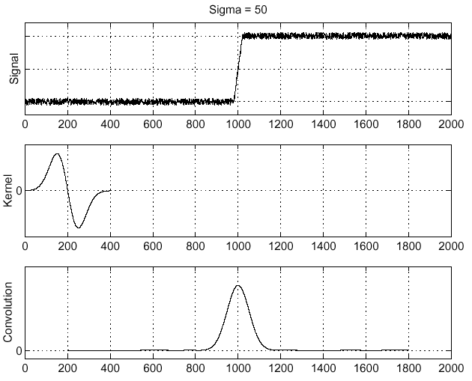
Derivative theorem of convolution
Differentiation property of convolution.
Slide credit Steve Seitz

Slide 27
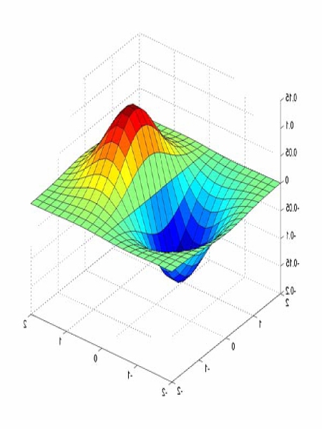
Derivative of Gaussian filters
0.0030 0.0133 0.0219 0.0133 0.0030
0.0133 0.0596 0.0983 0.0596 0.0133
0.0219 0.0983 0.1621 0.0983 0.0219
0.0133 0.0596 0.0983 0.0596 0.0133
0.0030 0.0133 0.0219 0.0133 0.0030

Slide 28
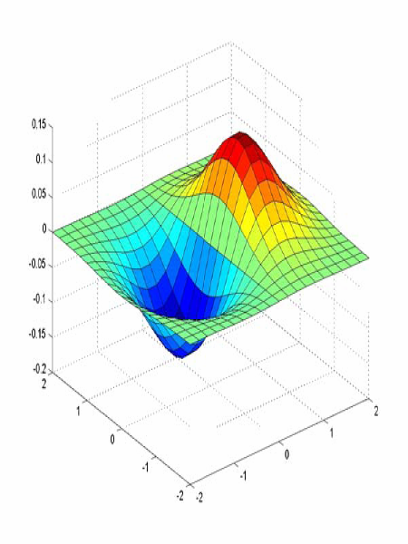
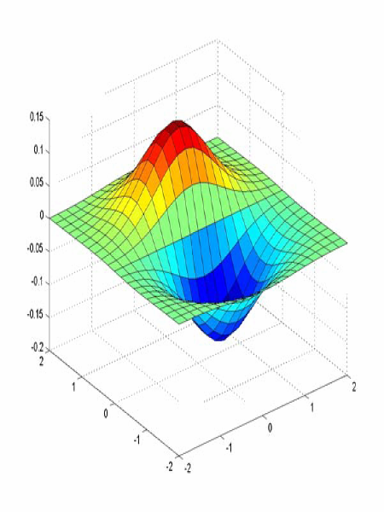
Derivative of Gaussian filters
x-direction
y-direction
Source: L. Lazebnik

Slide 29
Implementation in Matlab
% Given: IM – image and sigma – parameter of the Gaussian:
epsilon=1e-2;
halfsize=ceil(sigma*sqrt(-2*log(sqrt(2*pi)*sigma*epsilon)));
size=2*halfsize+1;
%generate a 2-D Gaussian kernel along x direction
for i=1:size
for j=1:size
u=[i-halfsize-1 j-halfsize-1];
hx(i,j)=gauss(u(1),sigma)*dgauss(u(2),sigma);
end
end
hx=hx/sqrt(sum(sum(abs(hx).*abs(hx)))); %normalization
%generate a 2-D Gaussian kernel along y direction
hy=hx';
%2-D filtering
gx=imfilter(IM,hx,'replicate','conv');
gy=imfilter(IM,hy,'replicate','conv');
function y = gauss(x,sigma)
%Gaussian
y = exp(-x^2/(2*sigma^2)) /
(sigma*sqrt(2*pi));
%%%%%%%%%%%%%%%%%%%%%
function y = dgauss(x,sigma)
%first order derivative of Gaussian
y = -x * gauss(x,sigma) / sigma^2;
It can be shown that convolving with a 2D Gaussian is the same that convolving with a 1D Gaussian in x direction followed by convolving in y direction!

Slide 30
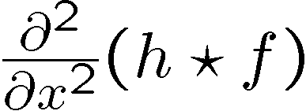
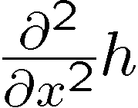
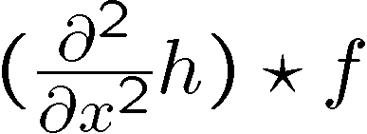
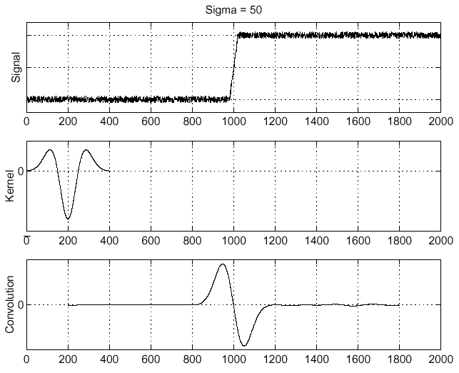
Laplacian of Gaussian
Consider
Laplacian of Gaussian
operator
Where is the edge?
Zero-crossings of bottom graph
Slide credit: Steve Seitz

Slide 31
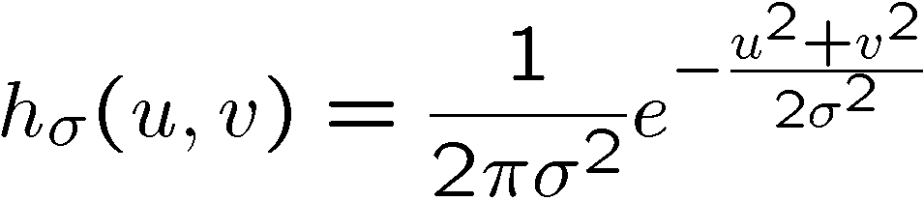
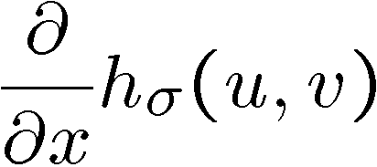






2D edge detection filters
Laplacian of Gaussian
Gaussian
Derivative of Gaussian
is the Laplacian operator:
Slide credit: Steve Seitz
Notes:
31

Slide 32






Smoothing with a Gaussian
Recall: parameter σ is the “scale” / “width” / “spread” of the Gaussian kernel, and controls the amount of smoothing.
…

Slide 33


Effect of σ on derivatives
σ = 1 pixel
σ = 3 pixels
The apparent structures differ depending on Gaussian’s scale parameter.
Larger values: larger scale edges detected.
Smaller values: finer features detected.

Slide 34


Laplacian
Matlab:
h=fspecial('laplacian',0.2);
imLaplacian=imfilter(im,h); % or:
imLaplacian=conv2(im,h)

Slide 35





Laplacian and zero-crossings
Using different sigma values.
Why edges obtained by the zero-crossing of the Laplacian map assure to be continuous?
Although the Laplacian operator convolved with the image leads to contours, they can be too much (depends on sigma).

Slide 36







So, what scale to choose?
It depends what we’re looking for.
We need previous knowledge about the right scale.
Or manage different scales. How?

Slide 37


Gradients -> edges
Primary edge detection steps:
Smoothing: suppress noise
(e.g. by applying a Gaussian filter)
2. Edge enhancement: filter for contrast detection
(e.g. applying a Sobel mask)
3. Edge localization
Determine which local maxima from filter output are actually edges vs. noise (from which value of the edges)
Binarization (thresholding): all pixels higher than a threshold put to 1, lower than the threshold put to 0.

Slide 38

Original image

Slide 39
Gradient magnitude image

Slide 40

Thresholding gradient with a lower threshold

Slide 41
Thresholding gradient with a higher threshold

Slide 42
Canny edge detector
Filter image with derivative of Gaussian
Find magnitude and orientation of gradient
Non-maximum suppression:
Thin wide “ridges” down to single pixel width
Linking and thresholding (hysteresis):
Define two thresholds: low and high
Use the high threshold to start edge curves and the low threshold to continue them
MATLAB: edge(image, ‘canny’);
>>help edge
Source: D. Lowe, L. Fei-Fei

Slide 43
The Canny edge detector
original image (Lena)
Slide credit: Steve Seitz

Slide 44

The Canny edge detector
norm of the gradient

Slide 45

The Canny edge detector
thresholding

Slide 46


The Canny edge detector
How to turn these thick regions of the gradient into curves?
thresholding

Slide 47

Non-maximum suppression
Check if pixel is local maximum along gradient direction, select single max across width of the edge

Slide 48
The Canny edge detector
Problem: pixels along this edge didn’t survive the thresholding
thinning
(non-maximum suppression)

Slide 49
Hysteresis thresholding
Use a high threshold to start edge curves, and a low threshold to continue them.
Source: Steve Seitz

Slide 50
Hysteresis thresholding
original image
high threshold
(strong edges)
low threshold
(weak edges)
hysteresis threshold
Source: L. Fei-Fei

Slide 51
Hysteresis thresholding
original image
high threshold
(strong edges)
low threshold
(weak edges)
hysteresis threshold
Source: L. Fei-Fei

Slide 52
Recap: Canny edge detector
Filter image with derivative of Gaussian
Find magnitude and orientation of gradient
Non-maximum suppression:
Thin wide “ridges” down to single pixel width
Linking and thresholding (hysteresis):
Define two thresholds: low and high
Use the high threshold to start edge curves and the low threshold to continue them
MATLAB: edge(image, ‘canny’);
>>help edge
Source: D. Lowe, L. Fei-Fei

Slide 53





Exercices (comparison)
Determine the operator applied:
Original image
Prewit with a mask
mask=[[-1, 0, 1];[-1, 0, 1];[-1, 0,1]];
imP=conv2(double(im),mask);
imshow(imP,[]);
Laplacian with a mask
mask=[[0,-1,0];[-1,4,-1];[0,-1,0]];
imLM=conv2(double(im),mask);
imshow(abs(imLM)<10,[]);
Sobel with a mask
mask=[[-1, 0, 1];[-2, 0, 2];[-1, 0,1]];
im2=conv2(double(im),mask);
imshow(im2,[]);
Laplacian with a mask
mask=[[0,-1,0];[-1,4,-1];[0,-1,0]];
imLM=conv2(double(im),mask);

Slide 54





Exercices (comparison)
Determine the operator applied:
Original image
Sobel
ims=edge(im,’sobel’);
imshow(1-ims,[]);
Laplacian of a Gaussian
Lapl=fspecial(‘log’);
imL=imfilter(im,Lapl);
imshow(imL,[]);
Laplacian of a Gaussian
Lapl=fspecial(‘log’);
imL=imfilter(im,Lapl);
imshow(1-im2bw(imL,0.08));
Canny sigma=1, thr=0.2
imC=edge(im,’canny’,0.2,1)
imshow(1-imC,[])
Canny sigma=2, thr=0.2
imC=edge(im,’canny’,0.2,2)
imshow(1-imC,[])

Slide 55






Low-level edges vs. perceived contours
Background
Texture
Shadows
Is Canny edge detector distinguishing these contours?

Slide 56






Low-level edges vs. perceived contours
image
human segmentation
gradient magnitude
Berkeley segmentation database: http://www.eecs.berkeley.edu/Research/Projects/CS/vision/grouping/segbench/
Source: L. Lazebnik

Slide 57

Learn from humans which combination of features is most indicative of a “good” contour?
[D. Martin et al. PAMI 2004]
Human-marked segment boundaries

Slide 58

Summing the brightness gradient magnitude with the color gradient and texture gradient approximates better the good contours.
[D. Martin et al. PAMI 2004]

Slide 59
Summary
Filters allow local image neighborhood to influence our description and features
Smoothing to reduce noise
Derivatives to locate contrast, high image gradient
Different edge detectors:
Sobel & Prewitt – fast but sensitive to noise
Convolution with the Gradient of a Gaussian –
Less fast but more robust
Using different sigma allows to smooth more or less
Canny edge detector – state of the art edge detector
Assures continuous and thin contours due to the hysteresis and the thinning steps.
Needs parameters
Edges used to contain good contours but also many other pixels with high intensity change
Still the question about the object contours is not solved!

